Slide 1

Problem Analysis
Coding
Debugging
Testing

Slide 2

In Problem Analysis phase, the internal logic of the program is planned.
Various program analysis techniques are used to represent the logic of the program.
Flowcharts, pseudo codes, algorithms and decision tables are mainly used tools for this purpose.
The Problem Analysis phase finds the most efficient method of developing a program.

Slide 3

After developing the desired logic and sequence of steps, to develop a program, the developers reach at the coding stage.
In the coding stage, a programming language like C,C++ is selected and the program instructions are coded as per the syntax os the chosen language.

Slide 4

The process of removing all kinds of errors in the program is called as debugging.

Slide 5

After removing all the errors from the program, it is executed and supplied with valid input to see whether the program returns the accurate output after taking accurate input.

Slide 6

Before starting the development of a program, its logical working is generally implemented, by using various analysis tools like Flowcharts, Algorithms, Pseudo codes and Decision Tables.
These tools depict the step by step working of the program and help the analyst to chose a particular logic or sequence of instructions.

Slide 7

A module consists of a series of program instructions or statements in some programming language.
A module as a whole has a unique name.
A module has only one entry point called main() function.

Slide 8
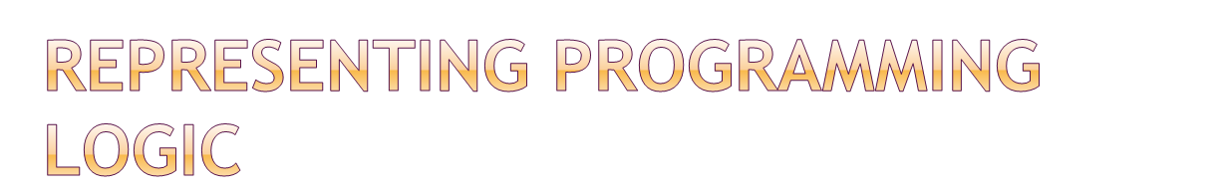
Algorithm
Flowcharts
Pseudo Codes
Decision Table

Slide 9

It can be defined as sequence of instructions to be carried out in order to solve a problem.
Algorithms are written in general English language.
These are independent of any programming language.
A problem may have multiple algorithms.

Slide 10

It makes the program easy to read and understand.
It makes the program portable and efficient.
It displays easy steps of processing.
It simplifies the modification and updation of the existing program.
It provides the facility for testing a program at developing stage.

Slide 11

Step 1. Start
Step 2. Let a=10, b=20
Step 3. c = a + b
Step 4. Print c
Step 5. Stop

Slide 12

The graphical representation of algorithm is called flowchart.
It is also called as symbolic diagrams of operations and the sequence, data flow, control flow and processing logic in information processing.

Slide 13





Terminal
Input/Output
Processing
Decision
Flow Line

Slide 14
Flow chart to input marks of a student in three subjects and print the total marks
START
SUM=0
M1=0
M2=0
M3=0
INPUT MARKS OF THREE SUBJECTS
SUM=M1+M2+M3
PRINT SUM
STOP

Slide 15

It represents the data flow.
It provides a clear overview of the entire program and problem and solution.
It documents the steps followed in an algorithm.
It provides the facility for coding.
It shows all major elements and their relationship.

Slide 16

Flowcharts are time consuming.
It is difficult to draw with proper symbols and spacing.
Little modification in flowchart needs to redraw the whole flowchart.
There is no standard for explaining the depth of detail that should be included in flowchart.

Slide 17

A decision table is a tabular form that presents a set of conditions and their corresponding actions.
Condition Stubs
It describes the conditions or factors that will affect the decision or policy.
Action Stubs
These are describes in form of statements.

Slide 18

TABLE HEADING
DECISION RULES
CONDITION ENTRIES
CONDITION STUB
ACTION ENTRIES
ACTION STUB

Slide 19

The decision tables are easier to draw and modify than flow charts.
They provide short and compact documentation.
It is easier to analyze the steps , which would be followed, when a set of condition is true than a flow chart.

Slide 20

It takes more time to understand the problem through decision table than a flow chart.
It is unable to demonstrate the sequence of steps as shown by flow charts.

Slide 21

Pseudo is a way of describing an algorithm without using any specific programming language.
Pseudo codes uses simple English language to express the logic and flow of the program.
It has no graphical or tabular syntax.

Slide 22
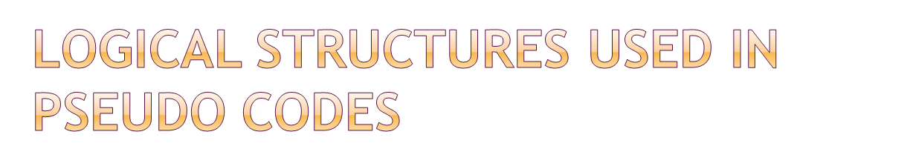
1) Sequence logic
It is used for expressing the sequence of
execution of instruction using top to bottom
approach.
2) Selection Logic
To take decision in the program.
3) Iteration
To repeat the execution of a set of instructions.

Slide 23

Set COUNT ADULT CHILD to 0
DO WHILE COUNT is not equal to 1000
Read the age of the person
IF AGE>=18 THEN
Add 1 to CHILD
ENDIF
Add 1 to COUNT
ENDDO
Write ADULT CHILD
STOP

Slide 24

It is very easy to convert a pseudo code into program of actual computer language.
Pseudo codes are relatively easy to modify in case of change in the logic of program.
Pseudo codes are relatively less time consuming than a flow chart.

Slide 25

No graphical representation is available with pseudo codes.
There are no standard rules to follow in using pseudo codes.
Pseudo code is difficult to understand foe beginner.

